Slide 1
Analyzing Promotional Campaign Effectiveness at AtliQ Mart
Ragul M

Slide 2
Agenda
Introduction
Data Overview
Ad-hoc Request
Store Performance
Promotional Type Analysis
Product Performance
Insights
Recommendations

Slide 3

Introduction
Atliq Mart, a retail giant with over 50 supermarkets across the Southern region of India, showcased its dominance during the festive seasons of Diwali 2023 and Sankranti 2024.
Extensive promotions were skillfully conducted by all 50 stores on their exclusive Atliq brand products,resulting in an increase in the festive mood and a rise in eager customers.
To analyze the effectiveness of these promotions and provide actionable insights for more future campaigns.

Slide 4
Data Overview
…….

Slide 5
.
Atliq Mart Sales Team provided datasets to analyze the Promotional Analysis
dim_campaigns
dim_products
dim stores
fact_events
retail eventsdb

Slide 6
Ad-Hoc Request
…….

Slide 7
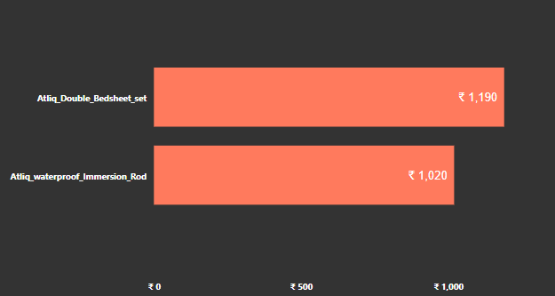

1. Provide a list of products with a base price greater than 500 and that are featured in promo type BOGOF("Buy One Get One Free)
SELECT DISTINCT p.product_name AS Product_Name, e.promo_type AS Promo_Type, e.base_price AS Base_Price FROM fact_events e
JOIN dim_products p ON e.product_code = p.product_code WHERE e.base_price > 500 AND e.promo_type = 'BOGOF';

Slide 8
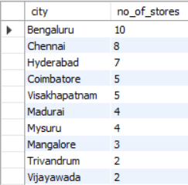
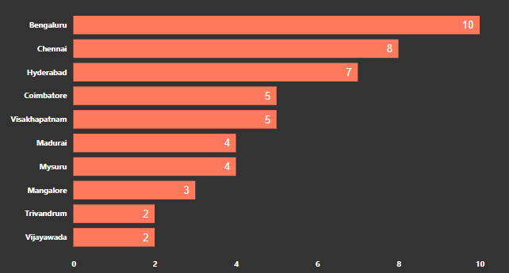
2.Generate a report that provides an overview of the number of stores in each city.The results will be sorted in descending order of store counts.
SELECT city, COUNT(store_id) AS no_of_stores FROM dim_stores GROUP BY city ORDER BY no_of_stores DESC;

Slide 9

3.Generate a report that displays each campaign along with total revenue generated before and after campaign?
SELECT c.campaign_name, CONCAT('$', FORMAT(SUM(e.base_price * e.quantity_sold_before_promo) / 1000000, 2), 'M') AS 'Total_Revenue(Before_Promotion)',
CONCAT('$', FORMAT(SUM(e.base_price * e.quantity_sold_after_promo) / 1000000, 2), 'M') AS 'Total_Revenue(After_Promotion)’ FROM fact_events e JOIN dim_campaigns c ON e.campaign_id = c.campaign_id GROUP BY c.campaign_name;

Slide 10
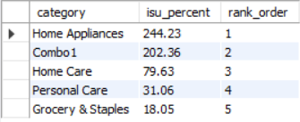
4. Produce a report that calculates the incremental sold quantity (ISU%) for each during the diwali campaign. Provide rankings for the categories based on ISU %
With ISU as (
SELECT
p.category,
ROUND(((SUM(e.quantity_sold_after_promo) - SUM(e.quantity_sold_before_promo)) / (SUM(e.quantity_sold_before_promo))) * 100,2) AS isu_percent FROM fact_events e
JOIN dim_products p ON e.product_code = p.product_code
JOIN dim_campaigns c ON e.campaign_id = c.campaign_id
WHERE c.campaign_name = 'Diwali’
GROUP BY p.category)
SELECT *,
RANK() OVER (ORDER BY isu_percent DESC) AS rank_order from ISU;

Slide 11
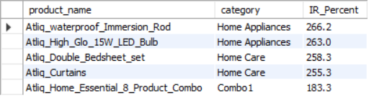
5. Create a report featuring top products, ranked by Incremental revenue percentage IR% across all campaigns.
SELECT p.product_name, p.category,
ROUND(((SUM((e.base_price) * (e.quantity_sold_after_promo)) - SUM(e.base_price * e.quantity_sold_before_promo)) / (SUM(e.base_price * e.quantity_sold_before_promo))) * 100, 1) AS IR_Percent FROM fact_events e JOIN dim_products p ON e.product_code = p.product_code GROUP BY p.product_name, p.category ORDER BY IR_Percent DESC LIMIT 5;

Slide 12

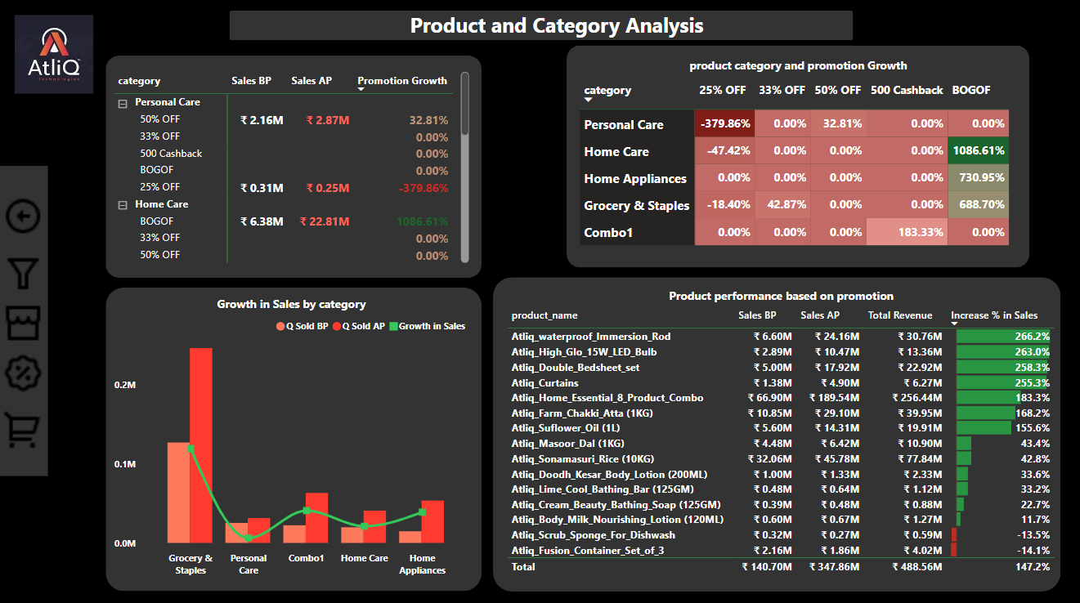
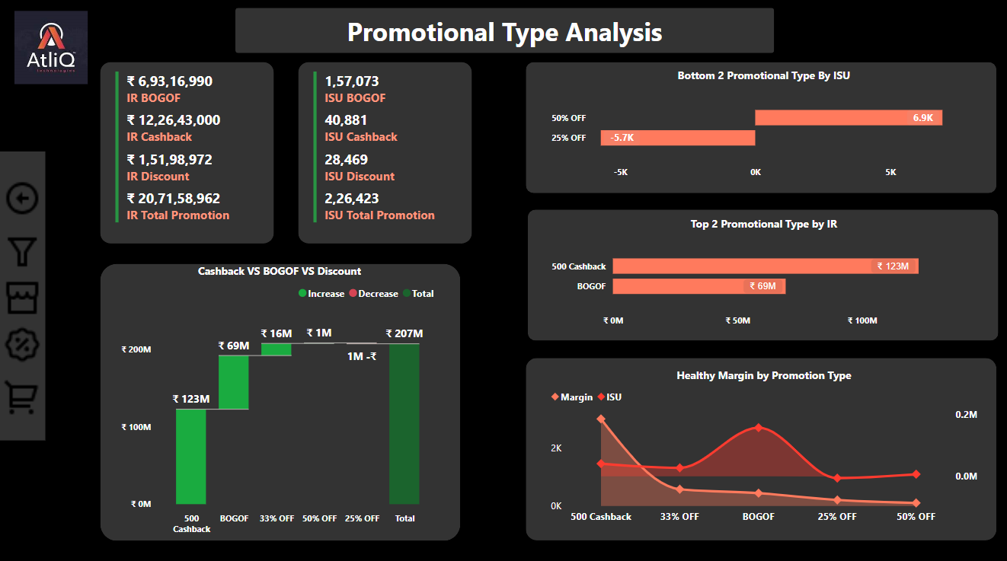
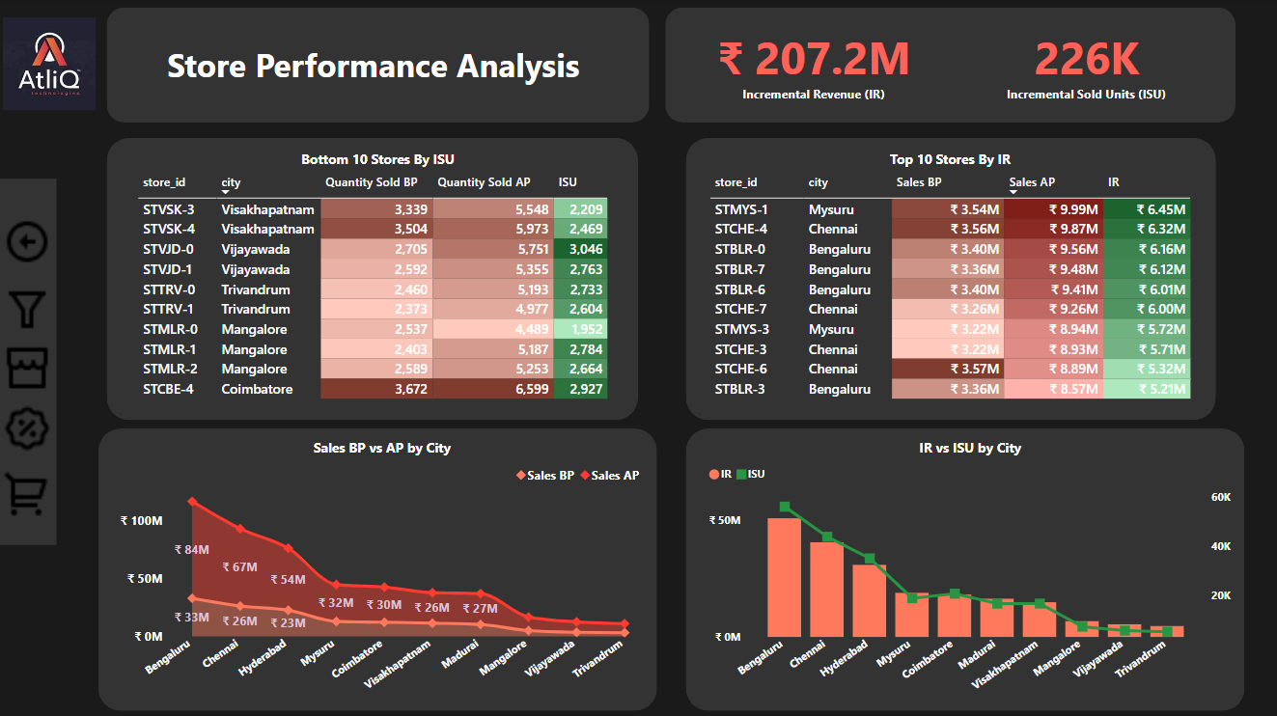
.
Promotion Analysis Report

Slide 13
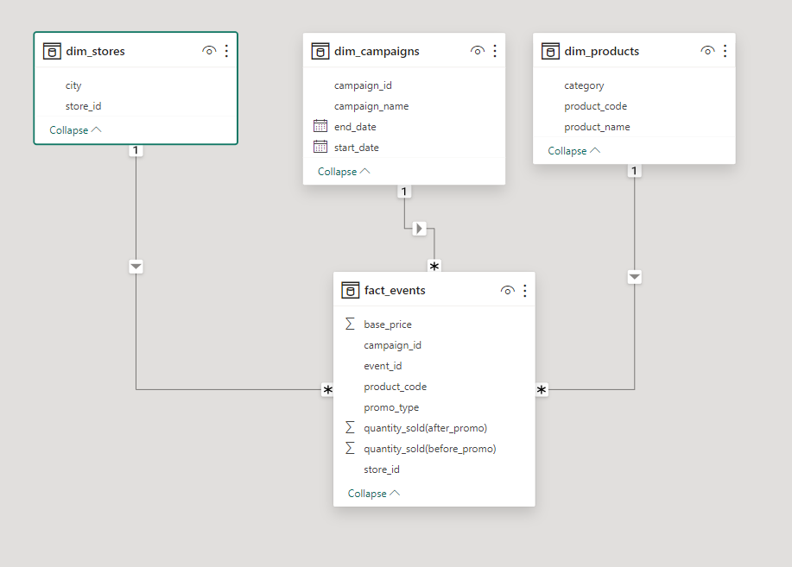
dim_stores dim_campaigns dim_products fact_events

Slide 14
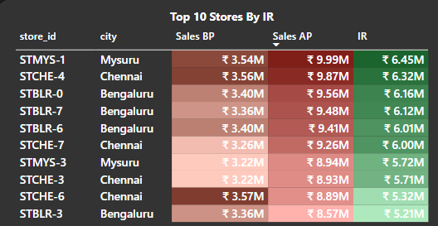
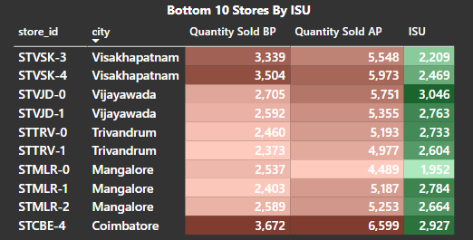
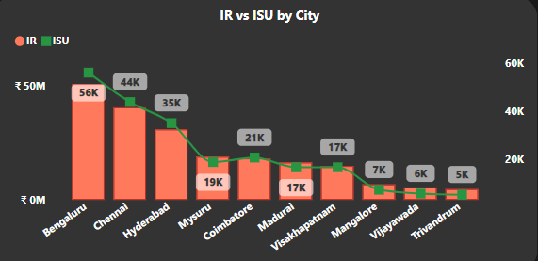
Store Performance Analysis

Slide 15
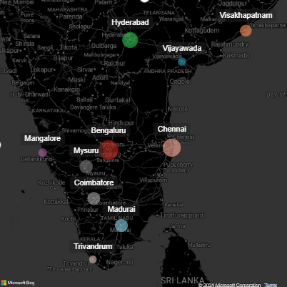
Store Performance Analysis
Top 10 stores by IR(Incremental Revenue)
STMYS-1 STMYS-3
STCHE-4
STCHE-7
STCHE-6
STCHE-3
STBLR-0
STBLR-7
STBLR-6
STBLR-3
Stores in Chennai, Bengaluru and Mysuru are having the highest sales among other stores.
Bottom 10 Stores by ISU(Incremental Sold Units)
Visakhapatnum
STVSK -3
STVSK-4
Vijayawada
STVJD-0
STVJD-1
Trivandrum
STTRV-0
STTRV-1
Mangalore
STMLR-0
STMLR-1
STMLR-2
Coimbatore
STCBE -4
Stores in Visakhapatnum, Vijayawada, Trivandrum, Mangalore and Coimbatore are having the lowest sold units among other stores.
Performance of stores by city
Bengaluru shares the highest IR and ISU among the other cities, followed by Chennai and Hyderabad
At 50.8 M , Bengaluru had
the highest IR and
Trivandrum which had a
lowest IR at 4.7M.
Bengaluru had the highest ISU at 56k units sold and Trivandrum which had the lowest ISU at 5K units sold.
Mysuru
Chennai
Bengaluru

Slide 16
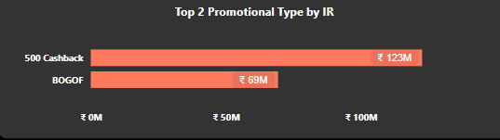
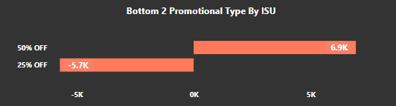
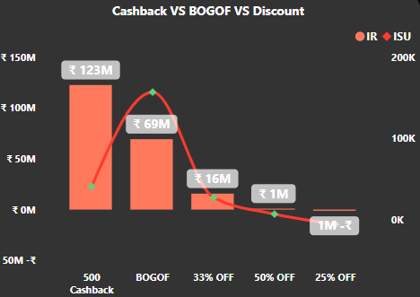
Promotional Type Analysis
Top two promotion types that resulted in the highest Incremental Revenue is 500 Cash back and BOGOF(Buy One Get One Free).
Bottom two promotion types in terms of their impact on Incremental Sold Units is 50% Off and 25%Off.
We can see there is a significant difference in the performance of discount-based promotions vs BOGOF(Buy One Get One Free) or cashback promotions.
Discount Based promotions have not performed well in terms of sales compared to BOGOF and 500 Cashback.

Slide 17
Promotional Type Analysis
Promotions strike balance between ISU and maintaining healthy margins?
Recognise Your Expenses:
Give a detailed breakdown of the expenses related to your product's marketing, distribution, and manufacture.
Determine the bare minimum of units you must sell to break even. This is known as your breakeven point.
Promotions Based on Value:
Highlight the benefits that buyers receive from your product.
Give promotions or discounts that highlight the value proposition without affecting the profitability.
Strategies:
Implement variable pricing based on demand, seasonality, and client categories.
Apply pricing strategies to present the product as more affordable without actually lowering the price much.
Identify different customer segments and modify promotions to fit their preferences. This gets rid of the requirement for general discounts and lets you maximise revenue from different customer categories.
Compute and Adjust:
Track the effectiveness of your promotions by implementing metrics.
Regularly evaluate the impact on sales, profits, and overall profitability. Ready to adjust your plan as needed based on how well certain campaigns work.

Slide 18
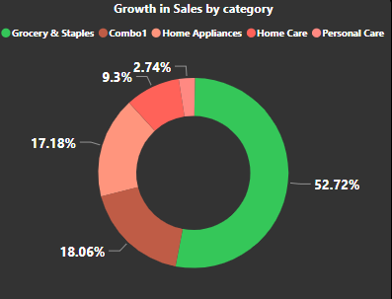
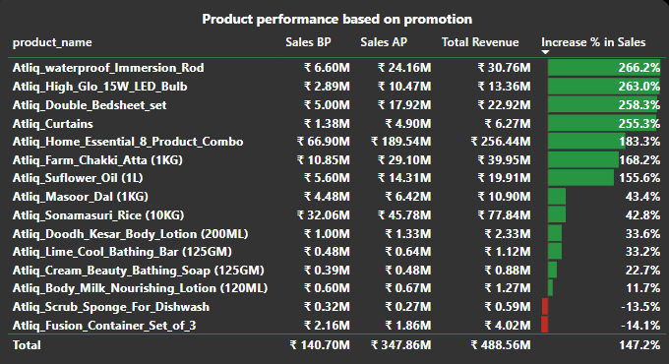
Product and Category Analysis
Grocery & Staples is the product category that experienced the most increase in sold units as a result of the promotions.
Grocery & Staples, Combo 1, Home Appliances and Home Care are the product categories that experienced the largest rises in sales as an outcome of the promotions.
Atliq Waterproof Immersion Rod
Atliq High Glow 15w LED Bulb
Atliq Double Bedsheet Set
Atliq Curtains
Atliq Home Essential 8 Product Combo
Atliq Farm Chakki Atta (1KG)
Atliq Sunflower Oil (1L)
Atliq Masoor Dal (IKG)
Atliq Sonamasuri Rice (10KG)
Atliq Doodh Kesar Body Lotion (200ML)
Atliq Lime Cool Bathing Bar (1 25GM)
Atliq Cream Beauty Bathing Soap (125GM)
Atliq Body Milk Nourishing Lotion (120ML)
Atliq Scrub Sponge For Dishwash
Atliq Fusion Container Set of 3
Performed Extremly good
There is increase in sales but profits are less
Poor

Slide 19
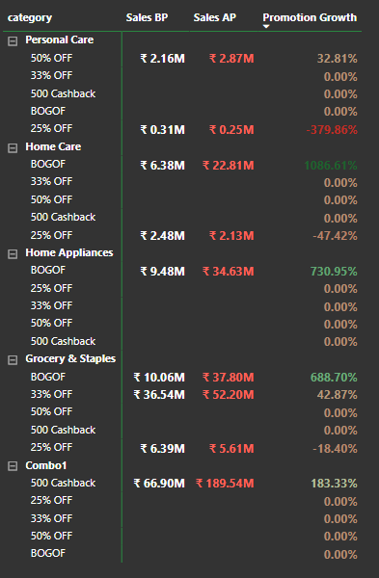
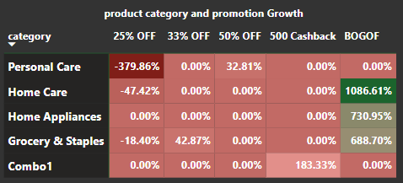
Product and Category Analysis
BOGOF promotions and their performance across different product categories had really increase in their sales and Home Care category had tremendous growth of 1086%.
Discount Based promotion had not performed well particularly in 25% OFF at Personal Care category had a loss of -380%

Slide 20
Insights
Bengaluru has the highest sales uplift, followed by Chennai and Hyderabad. It also has the highest IR (Incremental Revenue) uplift among the top 5 cities.
One of the common characteristics among the top-performing stores is stores that provided more offers (especially 500 Cashback & BOGOF) had higher IR, ISU.
500 Cashback and BOGOF are the top 2 promotion types that resulted in the highest Incremental Revenue.
50% OFF and 25%OFF are the bottom 2 promotion types in terms of their impact on Incremental Sold Units.
500 Cashback strike the best balance between Incremental Sold Units and maintaining healthy margins.
There is a significant difference in the performance of discount-based promotions versus BOGOF (Buy One Get One Free) or cashback promotions, BOGOF and Cashback performs better than discount based promotions.
Combo1 and Grocery & staples is the most significant lift in sales from the promotions.
Personal care product category respond poorly to promotions.
BOGOF and Cashback was better than discount based promotions resulting in higher ISU and IR.

Slide 21
Recommendations
BOGOF and Cashback promotions can be focused more for optimal results as the customers respond well to these promotions.
Discount-based promotions can be reconsidered, especially 50% OFF and 25% OFF, for better impact.
To increase profitability, concentrate on improving retail operations in Bengaluru, Chennai, and Hyderabad. You can also look into expanding into other prospective cities.
With the major contributions from the top three cities - Bengaluru, Chennai, and Hyderabad, concentrate on tactics, customer interaction, and operational effectiveness to increase revenue and sales even more.
For other high-value products, think about utilising comparable promotions to boost sales and draw clients.
Invest resources and marketing energy in categories with higher ISU% in order to take advantage of seasonal demand and increase incremental revenue.

Slide 22
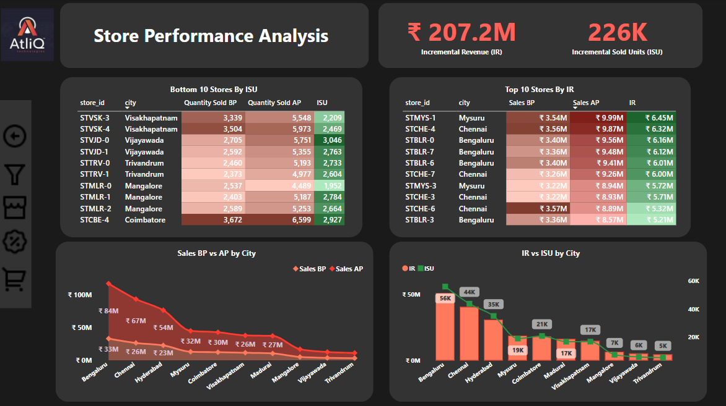

Slide 23
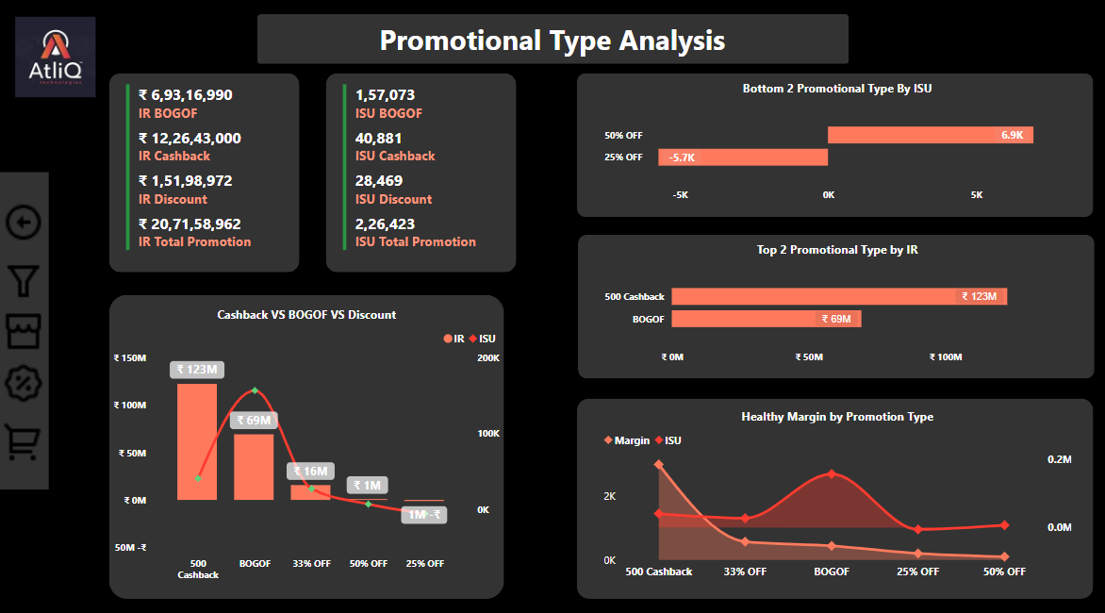

Slide 24
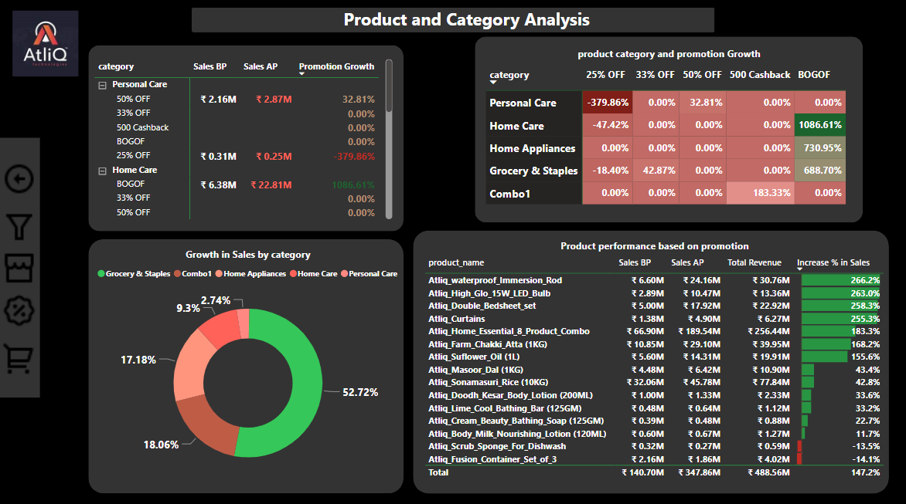

Slide 25
THANK YOU!!!
WEBSITE

